Slide 1
Introduction to Ugam’s Analytical Services Power Analytics Into Action

Slide 2
Ugam is an established managed analytics firm with multiple solutions , services and platforms
UGAM
Market research
Retail & Brands
Services
End to end Research Operations
Technology Infrastructure Solutions
Date Warehousing, Visualization and Reporting
Respondent Experience Solutions
Content services
Analytics services
MAP
monitoring
Solutions
Assortment intelligence
Content intelligence
Brand Intelligence
Pricing intelligence
Platform
Ugam’s Insights platform
Notes:
Ugam is an established managed analytics company, in existence for more than 13 years. We have two lines of business , Market research and Retail&Brands. The MR side of the business helps research organizations such as IPSOS, Nielsen etc...in conducting surveys and analyzing results. The offerings here include E2E Research operations (that includes Panel set up, suvey programming etc..) to technology solutions including mobile surveys. On the R&B side our offerings are customized to the clients need. Our technology platform (UIP) helps clients who have not invested in the state of the art Big data platform and require help leveraging such capability. Our solutions in the areas of Assortment, Content etc...help Retailers/Brands with critical decisions based on our established data and methodology. For example our best seller list based on democratic demand indicators is used by Merchants to append their assortment with trending products. Our MAP monitoring offering helps Brands push compliance on the Channel adhering to MAP prices. For problems that require greater customization, we also offer Content and Analytics services. Analytics services is the focus of our discussion today.
Overall, Ugam’s bouquet of offerings helps our clients solve a range of problems with our proven assets and expertise.

Slide 3
The interplay of different models that Ugam offers is a strong differentiator in the market
Platforms
Insights Big data platform
Assortment
Brand
Content
Pricing ...Intelligence
Content services
Analytics services
Services
Solutions
The business model is aimed to provide flexibility and maximum value to your business
Notes:
What separates Ugam from other vendors?
Our unique interplay of Platforms , Services and Solutions provides relevant answers to clients business questions and not force fit an offering. The model also allows for these offerings to be used in combination as the need arises. From a customers point of view this should help you with a seamless solution ; rather than having to manage hand off’s. This also helps you leverage our expertise in solving these problems by using the assets as required.

Slide 4





The recognition Ugam has received is testimony to its innovation and delivery excellence
2011
Notes:
The industry has validated Ugam’s capability and progress through these recognitions.

Slide 5





Ugam’s Analytics services offering has helped Retailers solve a range of business problems
Pricing
Mark down Pricing
Dynamic Pricing
Merchandizing
Best Seller products
Marketing
CRM
Marketing Mix analysis
Operations
Supply chain
Propensity models
Promotion effectiveness
Test Control
Pre Post
Double difference
ANOVA/ANACOVA
Web analytics
Drivers of traffic
Conversion levers
Paid search effectiveness
Drivers of Store productivity
Store performance monitoring
Measuring performance of in store promotions
Analyzing customer experience
Sentiment on stores
Offer attractiveness
Measuring Lost sales
Demand forecasting
Inventory management
Price Elasticity
Optimal size buy
Retention analysis
Net lift models
Leading indicators of Online ‘Out of Stock’
Alerts for leading indicators
Assortment planning
Product popularity driven by demand signals
Probabilistic & Deterministic models for EOQ & buffer stock
Identified assortment gap worth ~8 Mn
48% of product showed Google rank improvement
Notes:
Ugam’s Analytics expertise has helped various functions within a retailer solve specific business problems. Our solutions have seen tangible business impact for our clients. For e.x : Our best seller products have uncovered gaps in assortment that have helped increase the coverage and topline for customers. Our work on Price elasticity has highlighted product groups where customers could skim price to increase margins.

Slide 6





Ugam’s Analytics services offering has helped leading Brands solve a range of business problems
Pricing
List price setting
Promotion pricing
Channel
Trade promotion effectiveness
MAP violations
Marketing
Marketing Mix analyses
Product management & Design
Supply chain
Propensity for Grey marketing
Promotion budget planning & simulation
Web analytics
Drivers of traffic
Conversion levers
Paid search effectiveness
Drivers of Consumer choice
NPI performance forecasting
Analyzing customer experience
Customer sentiment
Brand positioning
Measuring Lost sales
Demand forecasting
Inventory management
Price Elasticity
Price Waterfall
ANOVA/ANACOVA
Leading indicators of Online ‘Out of Stock’
B2B : Deal pricing
Test control
Promotion effectiveness
Pre Post
Double difference
Product Attribute valuation
Probabilistic & Deterministic models for EOQ & buffer stock
Reduced MAP violations by x% across xxx
Notes:
Ugam’s Analytics expertise has helped various functions within a Brand solve specific business problems. Our solutions have seen tangible business impact for our clients. For e.x : Our MAP monitoring work for leading helps plug leakages in the channel to maintain brand equity and preserve margins.

Slide 7
Ugam’s differentiator in Analytics lies in the ability to deliver richer insights at scale using its existing assets
Technology Platform
...will reduce analysis cycle time and enable easy implementation
The Ugam differentiator
Expertise , Skills , Assets
...can be leveraged to increase ROI on analytics projects
Data
Ability to combine external data with internal will provide richer insights
Notes:
Why would you engage with Ugam for Analytics services?
Ugam’s Big data insights platform allows you to use ingest large and diverse data to perform analysis of varied complexity. This enables mining for richer insights
Ugam’s ability to crawl and extract data outside the firewall adds a dimension to analyses that would be incomplete without it. E.x : Price elasticity with competitive prices
The expertise we have built in creating our assets/solutions help you (customer) leverage learnings in the industry on the specific problems

Slide 8
Ugam’s team of decision scientists possess a range of skills required to provide solutions to your customized need
Tools
Techniques
Technology
SAS
R
Tableau
Google Analytics
Omniture
Linear modeling
Multivariate regression
General Linear models
Decision trees
Choice models
Survival analysis
Segmentation
Time series forecasting
Machine Learning
Nearest neighbor
Naïve Bayes
Hadoop
Python
Drools
Hbase
SQL
Graph
Hive
Notes:
Ugam’s pool of talent across Analytics and technology can be readily leveraged to solve a business problem.

Slide 9
We follow a trusted problem solving approach that increases your chances to glean insights you miss today
Problem Definition
Hypothesis generation
Data Collection
Analysis
Feedback/ calibration
Identify the objective
What are the triggers to solve the problem today?
What were the roadblocks to solve the problem so far?
What would success of the solution look like?
What are the MECE factors influencing the problem?
What is the nature impact these factors are expected to have?
What data would we need to test the impact of these factors?
Do we have data for the key factors identified?
What would it take to procure data that is currently missing?
Are there proxies for the missing data?
What assumptions would need to be made?
How do these assumptions impact the outcome?
Which method / technique is best suited to meet the objective?
Is the method valid under the assumptions?
Is the method scalable over larger datasets?
Does the output meet the desired consumption?
What dataset/scenario does the output need to be tested on?
Is there a need for the model (if any) to learn?
How would the feedback & learning be integrated back into the business process?
Is the output now sustainable?
Notes:
Since a lot of the business problems we deal with are open ended and in some cases not solved for earlier, we rely on a structured problem solving approach that increases our chances of approaching ‘the solution’.

Slide 10
Getting Started – A typical Pilot
 | Time* | Client | Ugam
Project KickOff | 1 week | Identify Pilot Category + sample products for analysis Key Questions and outcomes from Pilot Business SPOC | Define engagement structure, goals and acceptance criteria Project plan with Deliverables
Access to Data and Finalise Scope | 1 week | Access to sydicated data, Category Sales and Shipment data (for 3 or 6 months ) Historical Promotion Calendar Finalise Scope | Document findings Report on data quality and accuracy (accuracy, sufficiency and quality Treat data for missing values and outliers Documentation of business rules applied for data treatment
Interim deliverable and checkpoint | 2 weeks | Data clarifications (if any) Facilitate checkpoint meeting with all Stakeholders | Exploratory Data Analysis (univariate, mutlvariate, trends, interaction between variables) Determine solution approach Select appropriate statistical techniques that can be used Interim Report on results of EDA and other analysis conducted
Final deliverable and presentation | 1 week | Evaluate and interpret results Plan for Action Roadmap fior future and next Steps | Final Reports and Insights presentation to all Stakeholders Price Related Reports – Historical trends, Driver Analysis, Volume Impact of Price change Promotion Related Report – Historical Analysis, Promo Drivers , External Influence on Promotions , Breakdown Analysis of Promo Lift Roadmap for future work
ILLUSTRATIVE
* The time indicated for the Pilot is indicative. A formal project plan would be provided after the required due diligence, that would include the actual project timeline
Notes:
How can we start engaging?
- We could start with a Pilot project on a specific problem that is important to you
- The timelines are indicative
- The activities could differ slightly based on the problem statement

Slide 11
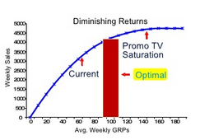
Created a decision support system to re-allocate spends across marketing channels and lines of business
Background and Objective
Key questions?
A leading retailer had a mass media budget of approx $450 Mn
Traditionally, 70% of these spends were skewed to one channel, In store Flyers
The realization in the business, that this distribution of spends does not reflect changing consumer shopping trends grew over time
While there was consensus on the need to change the spend distribution to more modern marketing channels, there was no existing mechanism for this re-allocation
How do we measure incremental impact due to marketing channels?
How do we reallocate marketing spends across lines of business?
Solution
Challenges
Spends and initiatives occur simultaneously, making revenue attribution to these channels difficult
Lot of the spends are common to various lines of business, leading to possible cannibalization and Halo effects
There are a lot of uncontrollable factors such as seasonality, consumer sentiment that need to be accounted for

Slide 12
Solution overview
Stage 1 | Activities
Data and requirement gathering | Understand the right metrics to measure Outline the existing process for spend allocation
Stage 2
Exploratory analysis | Discover data anomalies Decide on data treatment strategies
Stage 3
Model Building & Validation | Build econometric models for each line of business Validate model results with business reality
Stage 4
Calibrating model results with business planning process | Convert model output to spend recommendations Decide on adjustments based on media buying process
Insights
Business impact
TV investments offered higher ROI across all lines of business
There were significant Halo impact that could be leveraged to gain spend efficiency
Newer channels don’t have enough scale to show impact
Gained 2% incremental revenue despite a 5% spend cut
Put in place a measurement system that would measure the impact of future campaigns
Provided an option to carry out media tests before full roll out

Slide 13
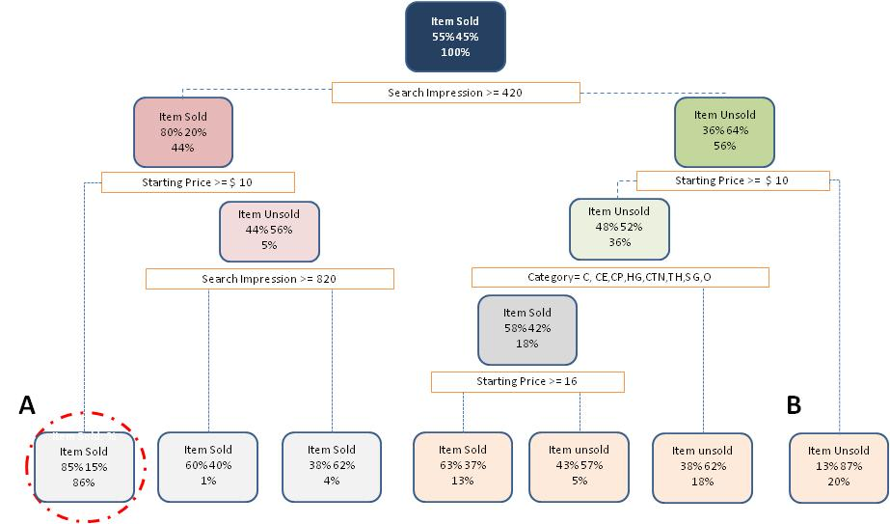
Analyzed drivers for low sell through for an online market place to recommend actions to improve conversion
Background and Objective
Key questions?
One of the largest online market places had a problem with a declining and volatile conversion rate in its “seller oriented program”
In general, business owners felt “Items were not selling”
The business would like to understand which of the multiple factors is most responsible for the lower conversion
What is the relative importance of the driving factors of conversion?
What actionable steps can be taken to improve conversion rate?
Solution
Challenges
Data on various factors are available at different granularity across different data sources.
The cause and effect nature of the factors is unclear
There were multiple initiatives over the last 10 months aimed at improving conversion

Slide 14
Solution overview
Stage 1 | Activities
Problem definition | Identify the right metric to define conversion Baseline KPI performance
Stage 2
Problem exploration & Initial data analysis | Identify potential driving factors of conversion (Factor Map) Map data available to the factors Create hypotheses for the respective factors
Stage 3
Model Building & Validation | Run decision tree on common available data Analyze impact of factors at different granularity
Stage 4
Recommendations | Socialize data findings to business groups to arrive at root causes Discuss with business/technical team to arrive at solution option
Insights (Table)
Business impact
Listing of very low priced items brought down the conversion
Presence of these items impacted search impressions of other items too
Listings with lower quality contributed to lower conversion too
Other factors such as shipping, product type did not have much of a role to play
Based on the analysis, a separate “seller” was created for very low priced items
This improved the Search impressions on high velocity items by 13% and conversion by 6%

Slide 15
Potential drivers of conversions were analyzed based on data availability
S.No. | Factors for Analysis | Available | Used | Significant Impact
1 | Product Type |  |  | 
2 | Starting Price |  |  | 
3 | Listing Quality˚ |  |  | 
4 | Search Impression, Page view, Watchers |  |  | 
5 | Bundled items |  |  | -
6 | Processor Type |  |  | -
7 | Item Condition |  |  | -
8 | Shipping Price⁺ |  |  | -
9 | Listing Type* |  |  | NA
10 | Initiatives |  |  | NA
11 | Low Price item on eBay listing |  |  | NA
12 | Price of item relative market/competition |  |  | NA
13 | Market Demand |  |  | NA
* Listing Type is skewed towards Auction items & hence not analyzed
⁺ Shipping Price available only for item sold
˚ Listing Quality data is only a random sample for 5 Product type

Yes
No significant impact
Back

No
Notes:
Only random sample – update
Shipping Price-update
Impact- update
***impact – measure of how much a particular factor able to diff b/w sold n unsold items

Slide 16
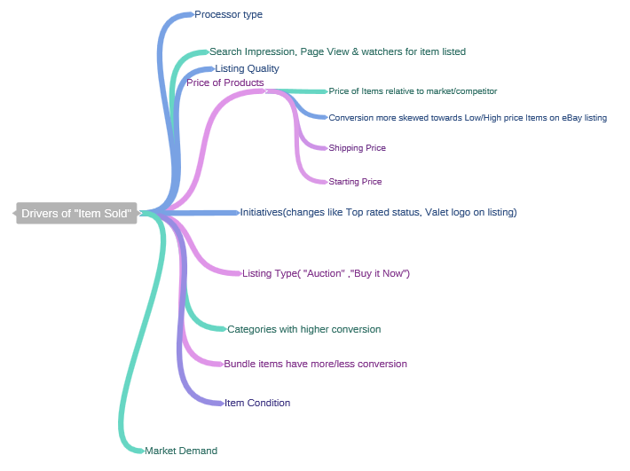
Factors that could influence whether an item gets sold or not
Back

Slide 17
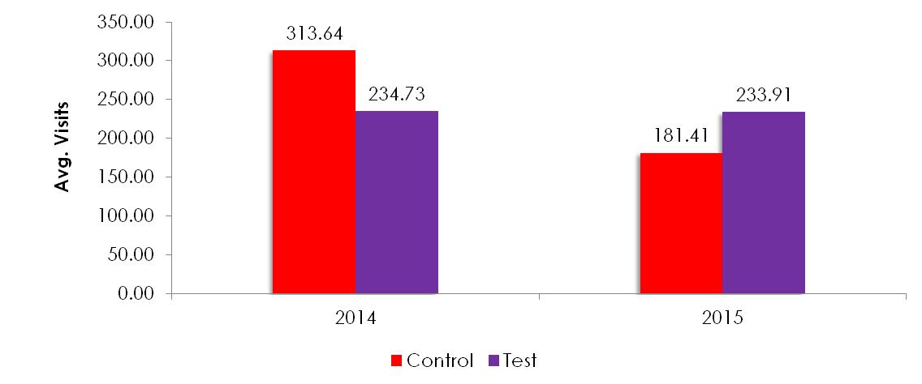
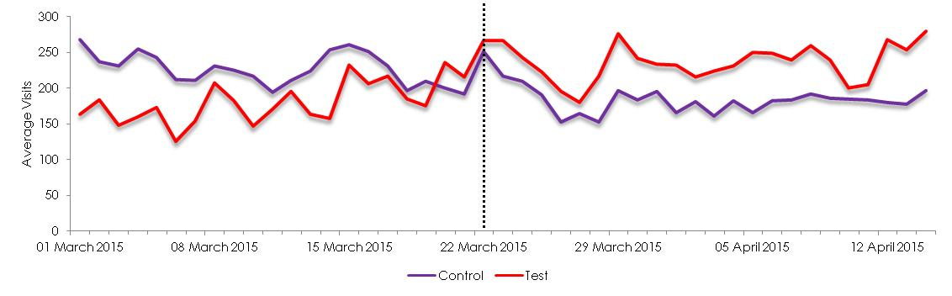
Incorporating a test and learn approach to making content interventions with an agile feedback loop
Background and Objective
Key questions?
A large retailer was struggling to get natural traffic to its website
Web content was identified as one of the root causes to have Sub optimal SEO results
Ugam used concepts of Latent semantic Indexing and SEO principles to improve Traffic to the website
But before rolling out these changes to all category pages, Ugam proposed a test to gauge the effectiveness of the changes and learn from results
What is a robust method to measure performance improvement in Web traffic?
What insights can be drawn to improve the content intervention plan before roll out?
Solution
Challenges
A statistical test was performed on visits across test and control groups
Category pages were divided into Test and control groups based on Euclidean distance
The re are no existing benchmarks to gauge improvement
Content changes were made on a limited number of category pages
The test and learn plan needed to integrate with the larger content roll out plan, leaving limited observation time

Slide 18
Solution overview
Stage 1 | Activities
Problem definition | Identify KPI’s to measure impact of content interventions Understand implementation plan to devise the right test
Stage 2
Baseline | Devise test and control groups Validate homogeneity across the groups
Stage 3
Run analysis | Collect data on KPI’s across Test and control groups Run appropriate test to measure success
Stage 4
Insight/Feedback loop | Deep dive into dimensions (page/day) to identify pockets of varying performance Check for any external influences that might impact results
Insights
Business impact
The engagement metrics of Time on page, conversion did not show much improvement
Other content categories such as videos, images etc.. were identified to improve the engagement metrics
Content interventions did improve overall traffic by 25% and this increase was statistically significant

Slide 19
Designing and implementing a measurement framework for Direct mail campaigns
Background and Objective
Key questions?
Direct mailing was the major channel in the client’s one-to-one marketing strategy
Spend on Direct mail campaigns was about 25% of the total marketing spend
While the impact of DM was visible , but it was not quantified
There was a feeling that the DM spend could be more efficient by prioritizing campaigns with better ROI & smarter targeting
Overall, there was a need for a measurement framework for the different campaigns
What is a robust method to measure a variety of campaigns
What insights can be drawn to enable continuous improvement
Solution
Baseline methodology | When would we use it?
Pre-Post | Categories not affected by seasonality
Test - Control | Creating control groups is feasible
Modelling | Simultaneous campaigns
Challenges
Preferred Lift calculation - > Double difference methodology
Campaign analysis included
Statistical test to measure impact
Drill down analysis by time, customer segment and campaign communication element
Campaigns are of varied objective, duration and targeted at different customer segments.
This makes it difficult to have a standardized success criteria for the campaigns
Results have to be timely to have a smooth feedback loop into forthcoming campaigns

Slide 20
Solution overview
Campaign design
Target list selection
Impact measurement
Deep dive analysis
Feedback to future campaign
Engagement Value add
Business impact
The analytics team had a deep impact in uncovering campaign specific insights and importantly closing the feedback loop
A critical benefit to the client was being able to translate the analysis in business friendly results
The client could now get insights at scale, speed and granularity for repeatable campaigns
Enabling this continuous improvement cycle in the campaign life cycle contributed to the overall DM campaign ROI improving by 12% over 2 years

Slide 21
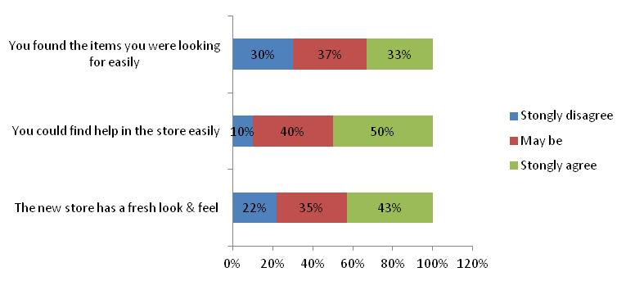

Mining store survey response and social buzz helped a large retailer fine tune its new format roll out
Background and Objective
Key questions?
A large specialty retailer was re-branding a section of its store.
This involved change in the store layout, signage and customer rep availability
The aim was to provide a better and fresh customer experience in the stores
To ensure that the investment in the re-design was worthwhile and fine tune the roll out the client wanted to augment anecdotal evidence with data
They wanted to leverage instore survey responses in whatever way possible
Could social media supplement the internal store survey data to provide a complete picture of the customer experience?
How could the unstructured data be translated to actionable insights?
Solution
Challenges
The in store responses were found to be biased towards the more loyal customers
Most of the responses were to the objective questions,, very little free text responses.
This limited the amount we could learn softer aspects of the experience

Slide 22
Solution overview
Stage 1 | Activities
Identify focus areas from survey results | Short list areas that saw the least improvement Focus on areas that pertained to the store design change
Stage 2
Pull Social media data | Identify relevant social media platforms Gauge volume of data available Clean/Scrub to get usable data
Stage 3
Run analysis | Use a combination of themes, word cloud and sentiment analysis Run association of these with the design change
Stage 4
Insight/Feedback loop | Identify 1 or 2 actionable aspects Extract any store or geography specificity (if available)
Insights
Business impact
Ease of Item identification was found as a concern area in the survey
The text data found that this was especially in the Toys section and possibly at night due to insufficient lighting
Being a critical re-design initiative, some of these insights were critical in fine tuning the roll out plan of the initiative.
Benefit quantification was difficult because of the nature of the problem and insights

Slide 23
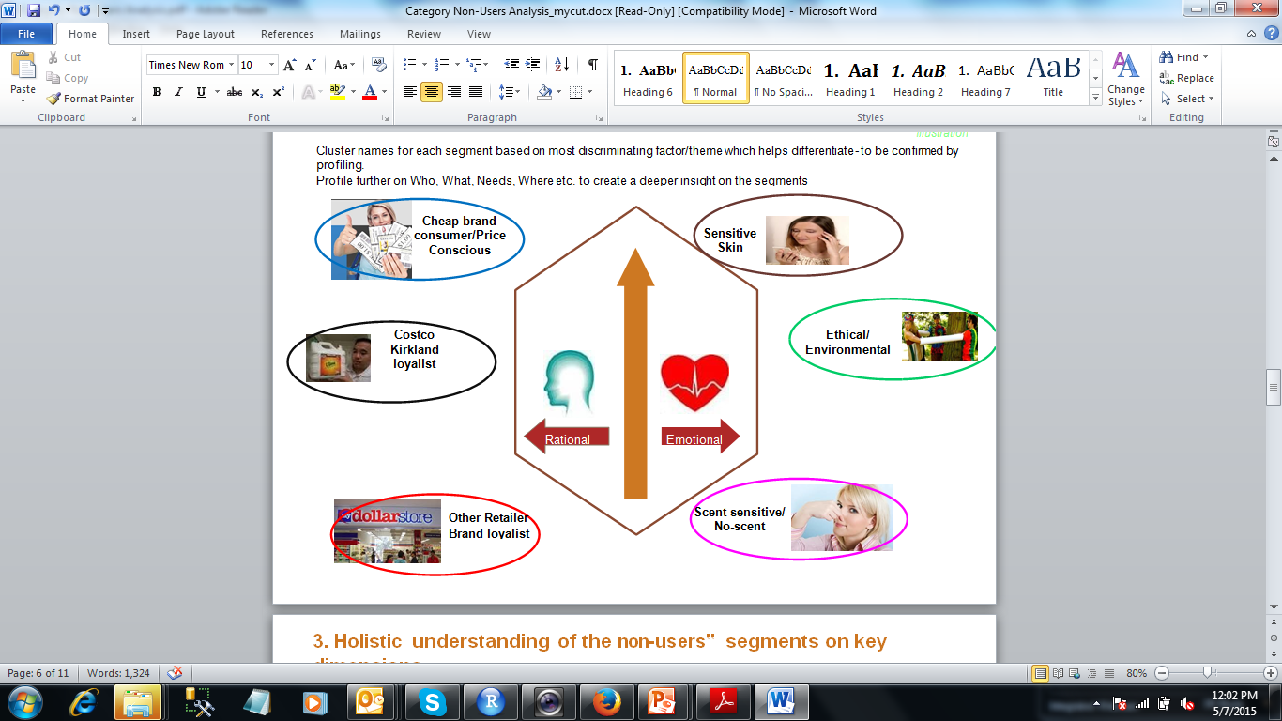
Understanding the “Non Users” of a Brand to tap in new consumers
Background and Objective
Key questions?
XYZ brand understand and serve their consumers (users) well, however the understanding of “non-users” has been limited and there is an opportunity to tap into this segment and look for ways to trade-in new consumers towards XYZ brand
Recommend potential ways to attract / formalize initial strategic plans for getting new users for XYZ brand along with
Identifying meaningful segments in the non-user base,
Detailed profiles of those segments and
Segment sizes & potential size of prize opportunities
Who are the non users of the XYZ brand
What are they looking in a product. What are their need
How big is the current non user segment
Solution
Challenges
Identification of the themes for customer segments
Prioritizing amongst the non user segments
Estimation of the Market size of the segments

Slide 24
Solution overview
Stage 1 | Activities
Identify Non Users from survey results | Non users- Never used a Brand in Past 12 Months Identify the most discriminating themes amongst non users by using factor analysis
Stage 2
Segmentation of non -users | Using discriminating themes non-users are segmented into groups Groups are homogeneous within themselves and heterogeneous with others
Stage 3
Detailed profiling of segments | Detailed profiling of the segments to understand them better Who are they? What are their needs? Current need-gaps? Where do they buy? Which brands they buy? Media exposure?
Stage 4
Non-User Segment Priority Analysis | Build an objective scorecard to determine relative importance of the segments Recommend the focus segments to target & convert the non-users into users
Business impact
With little additional investment in marketing communication Brand was successful in tapping new customers
It also helps in identification of white space in client’s offering
Currently analysis is also being used in new product development

Slide 25
Identify the growth opportunities for the XYZ brand with the help of country clustering
Background and Objective
The Female Hair Removal category is growing in various forms and countries worldwide.
Brand XYZ is looking to further define the global marketplace and understand its diverse consumer base
Recently XYZ/Female Hair Removal business has been merged with ABC to form a ‘Mega-Skin’ category
Due to recent changes Brand wants to
Develop a Global Mega-Skin (female hair removal and skin care) market clustering model and profiles per cluster
Challenges
Identification of key variables that will divide countries into homogeneous groups
Countries in a cluster should have similar attitude towards the category
Key questions?
Which countries group to form clusters for the FHR/Skin category, based on consumer, category & macro variables
What are the consumer profiles from key countries (age, income, kids, education, etc)

Slide 26

Solution : Cluster formation
Explanation of steps
All Scope Countries
Clusters of countries
based on
macro-economic
variables
Macro-Economic Variables
Developed
Developing
Clusters based on the total FHR category/ Wax & Cream/Shave Prep & Epilators usage
FHR/Wax & Cream, Shave Prep/Epilators
Developed 1
Developed 2
Developing 1
Developing 2
Split on Consumer Habits Practices ,preferences & attitudes
G1
G2
G4
G5
G6
G7
G8
Profiling of groups
Profile clusters on:
G3
Multiple Format/method
Body Part Usage
Skin Care Usage
Demographics
Category Activity
Attitude ..etc.

Slide 27
Solution overview
Stage 1 | Activities
Data Preparation | Collate the macro economic variables from different sources Identify category specific variables from the survey results
Stage 2
Country Clustering | Cluster the scope countries based on Macro economic variables Category variables Consumer related variables
Stage 3
Cluster Profiling & Trend analysis | Profiling the identified clusters based on Method used for hair removal by body parts Skin care habits for different body parts
Stage 4
Collation & recommendation | Collate overall results to recommend actionable steps to be taken and way forward
Insights
Business impact
Skin Care regimen of Consumers in Developed cluster is very elaborate as compared to Developing cluster.
Usage of Hair removal is very high on special occasion in Developing cluster
Analysis helped brand to target specific segment in more accurate way than broad scale marketing
Also, targeting specific segments were economical

Slide 28
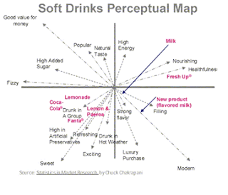
Assess the existing market, to determine how consumers perceive brands and the nature of consumer preferences
Background and Objective
Key questions?
A Beverage manufacturer wished to plan the optimal positioning of one of his products /Brand
Brand wants visual representation of the pattern of similarities or dissimilarities among a set of Beverages Brands
To deduce what criterion people use when judging the Brand
What all attributes consumer associates with the Brand under consideration
What all brands of beverage are perceived similar
Solution
Perceptual Map for Beverages
Challenges
It is generally easier to work with two-dimensional maps than with those involving more dimensions but theory or past research may suggest a particular number of dimensions

Slide 29
Solution overview
Formulate the Problem & Obtain input data
Select MDS procedure
Decide on the number of Dimensions
Label the dimensions and interpret the configuration
Assess reliability and validity
Insights
Business Impact
There are attributes which are important for consumers but currently not offered by any beverage brand
It allowed Brand to see what space product occupies in the customer’s mind & what they intended
It also allowed Brand to identify white space opportunities

Slide 30
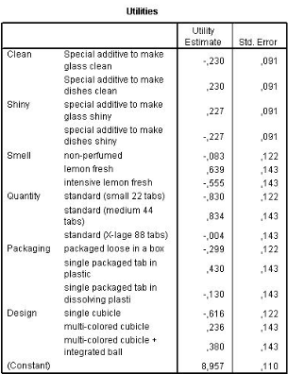
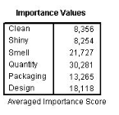
Constructed the choice simulator for the prediction of consumer judgements of new attribute combination
Background and Objective
Key questions?
What are the important attributes that could affect preference?
What do the respondents actually evaluate?
A popular brand of XYZ wants to introduce a product with new combination of attributes
Brand wants to understand
the price which can maximize the utility/value for the consumer based on current offering
Want to understand the relative importance of the attributes
Solution
Challenges
Attributes must be distinct and represent a concept that can be implemented precisely
Some attributes may be relatively new and hence consumer can not understand the value of such attribute properly

Slide 31
Solution overview
Stage 1 | Activities
Survey design and data collection | Design the Survey questionnaire Understand the factors (attributes) and level
Stage 2
Estimating technique | Based on data and business problem select the appropriate estimation technique
Stage 3
Model Validation | Validate model results with business reality
Stage 4
Applying the conjoint results | To simulate any number of competitive scenarios construct a choice simulator
Business Impact
Value creating factors were revealed on individual customer level
Brand was able to find profit maximizing configuration by combing customer preferences to product attributes with corresponding cost data

Slide 32
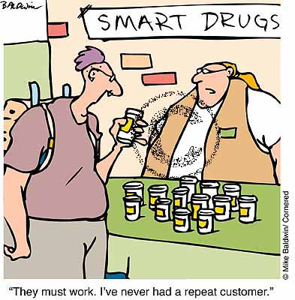
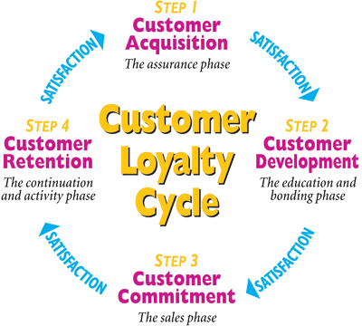
Diagnosing Customer Retention : Loyal advocates to the brand
Background and Objective
Popular XYZ service provider wants to emphasis customer to switch from 2G to 3G network.
Understand behavioural intentions as an indicator of customer retention based on premise that intentions are
strong predictions of future behaviour.
Enhance Demographic characteristics involves Age, Income, Loyalty programme membership & Firm size.
Identify key lever(s) that drive customer value.
Challenges
Visualization
Key questions?
Bulk of the evidence is unambiguously clear ; is
there a positive association between customer
satisfaction & customer retention.
Does customer-delight more strongly applicable to
hedonic goods & services rather than for utilitarian
products & goods.

Slide 33
Solution overview
Stage 1 | Activities
Survey design and data collection | Collect latest price points, feature ad & display. Identify customers leveraging customer loyalty programme.
Stage 2
Estimating technique | Estimate(Logistic/retention) category of outcome attribute(display). Check how likely the retention would occur. Find odds in having customer retention.
Stage 3
Model Validation | Check while the process driven customer satisfaction increases the life span of customer.
Stage 4
Applying the results | Accelerate retention rate as the percentage of total number of customer retained.
Business Impact
Implementation of customer service standard leads to improved customer service
practices, higher level of customer satisfaction in turn increases customer loyalty &
customer retention.
Differentiate between long-term customers(may not profitable) & worth retaining
whilst short term customers(may be profitable) for the firm.

Slide 34
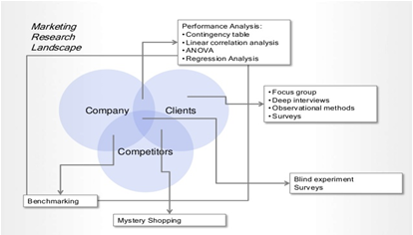
Does homely country made product drive same business line-up upon foreign visits?
Background and Objective
XY & AB company interested in competing with products produced in foreign countries and home country’s
products are exported to foreign countries where they are the foreign country products.
For instance, a Japanese consumer in Tokyo may be comparing the very same brands, but now Japanese brand
is the home country brand.
Americans are nurtured in an individualistic culture, so the value competition, self-reliance, and being distinctive,
which product will they buy?
Visualization
Challenges
Vital ones for global marketers because the
ways consumers make decisions about products with
foreign country origins have important implications about
the marketing strategies a global marketer should use to
gain competitive advantage in each of the countries
where its products are sold.
Key question?
Find same marketscape : Superior Japanese
products, lesser Japanese products, superior
American products and lesser American products.

Slide 35
Solution overview
Stage 1 | Activities
Survey design and data collection | Collect data from Home & Foreign countries of all respective products. Survey which customers are products dependent.
Stage 2
Estimating technique | Linear relationship among various attributes(Linear regression) Estimate most likely consumer products as home & foreign products.
Stage 3
Model Validation | Validate product performance based on model accuracy.
Stage 4
Applying the results | Predict which products are significant enough for consumers. Evaluate whether Home & Foreign products are inter-dependent.
Business Impact
American consumers, chose the superior brand, regardless of the country of origin.
Concluded that any global marketer must be aware of the strong home country product favouritism
they will face in countries where the culture is collectivist.
Caution that “Buy American” slogans issued by U.S. marketers at U.S. consumers probably have not
worked for lesser-quality products but “Buy Japanese” seems to work quite well in Japan regardless of
the quality of the Japanese products.

